Slide 1
Mind vs. Brain
How to leverage psychology to help us be better at our jobs.
Rob Bollons • @robbollons • thenorthcode.net

Slide 2
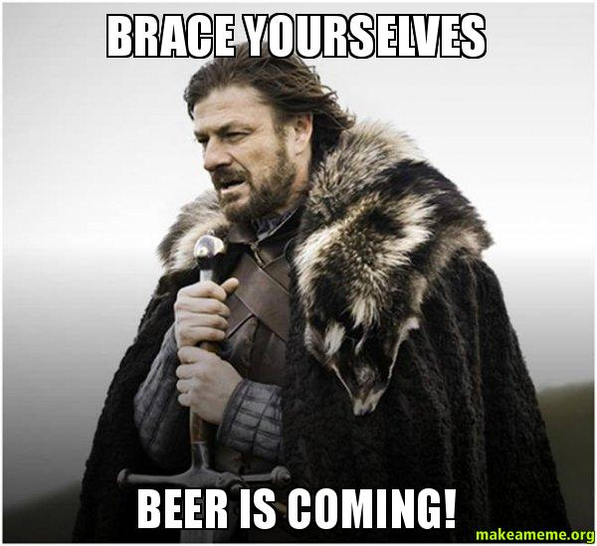
What’s This All About Then?
How to make better decisions.
Improving motivation.
Improving general wellbeing.
Secret to making the best cup of coffee in the world.

Slide 3
Making Better Decisions

Slide 4
‘We can just list the reasons why re-writing is the much better option’.

Slide 5
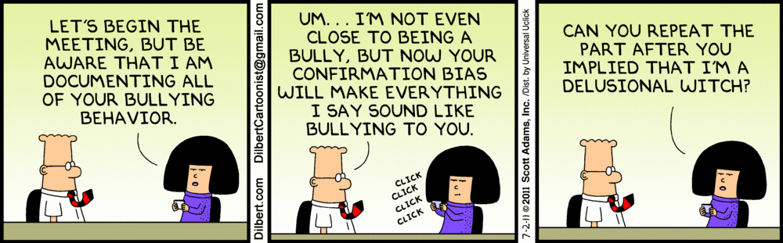
Confirmation Bias:
People favour information that confirms their beliefs.

Slide 6
In relation to dealing with legacy issues…
‘we have spent a lot of time fixing bugs and adding features, It would be crazy to waste all that time and effort on re-writing it’

Slide 7

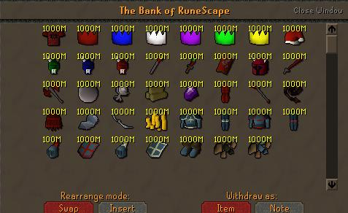
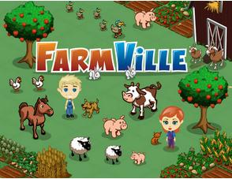
Sunk Cost Fallacy:
Having already invested so much in a project it is hard to abandon it despite a high likelihood for it to fail.

Slide 8
List of Biases
Ambiguity effect - The tendency to avoid options for which missing information makes the probability seem "unknown.
Anchoring - he tendency to rely too heavily, or "anchor," on one trait or piece of information when making decisions (usually the first piece of information that we acquire on that subject)
Backfire effect - When people react to disconfirming evidence by strengthening their beliefs.
Bias blind spot - The tendency to see oneself as less biased than other people, or to be able to identify more cognitive biases in others than in oneself
Decoy effect - Preferences for either option A or B changes in favor of option B when option C is presented, which is similar to option B but in no way better.
Distinction bias - The tendency to view two options as more dissimilar when evaluating them simultaneously than when evaluating them separately
Focusing effect - The tendency to place too much importance on one aspect of an event
Framing effect - Drawing different conclusions from the same information, depending on how or by whom that information is presented.
Hostile media effect - The tendency to see a media report as being biased, owing to one's own strong partisan views.

Slide 9
How Can We Avoid Making These Mistakes
Admitting that there’s a problem.
Approach critical decisions with caution.
Decision making models.

Slide 10
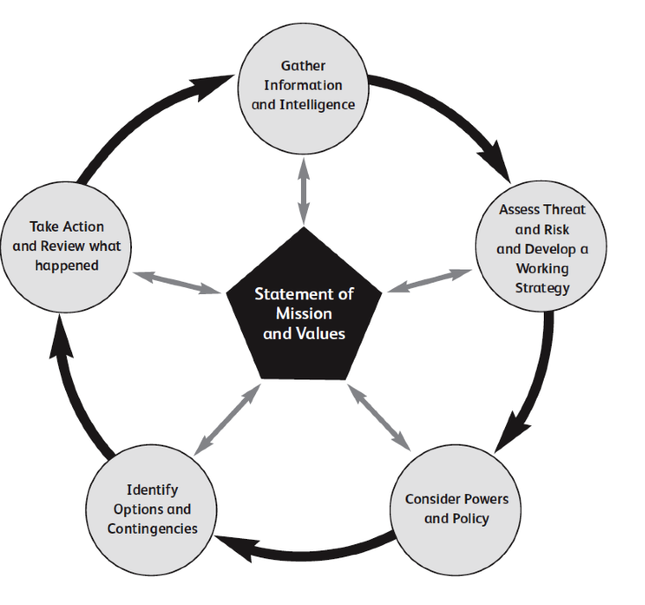
National Decision Making Model

Slide 11
Improving Motivation

Slide 12
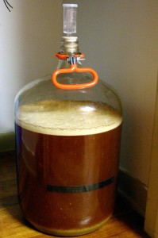
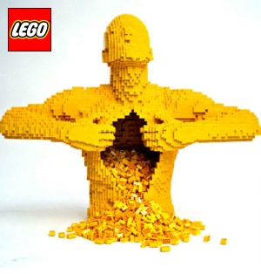
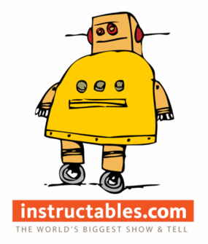
Ikea Effect
We place disproportionately greater value on our own creations.
Derived from the idea of self-assembled IKEA furniture.

Slide 13
Breaking down work into smaller chunks – the right thing to do?
Might affect motivation in larger teams.
Lack of ownership
Loose the ability to see ‘the bigger picture’

Slide 14
Improving General Wellbeing

Slide 15
Simple Things to Improve Your Work Environment
Plants
Paint walls
Decorate your desk

Slide 16
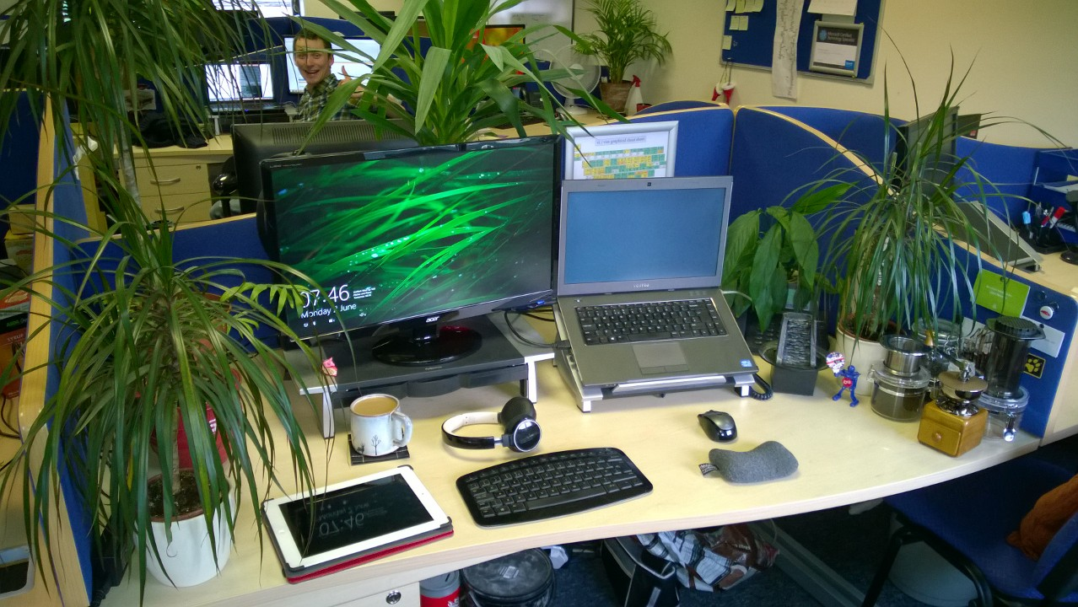

Slide 17
Climbing Mountains

Slide 18
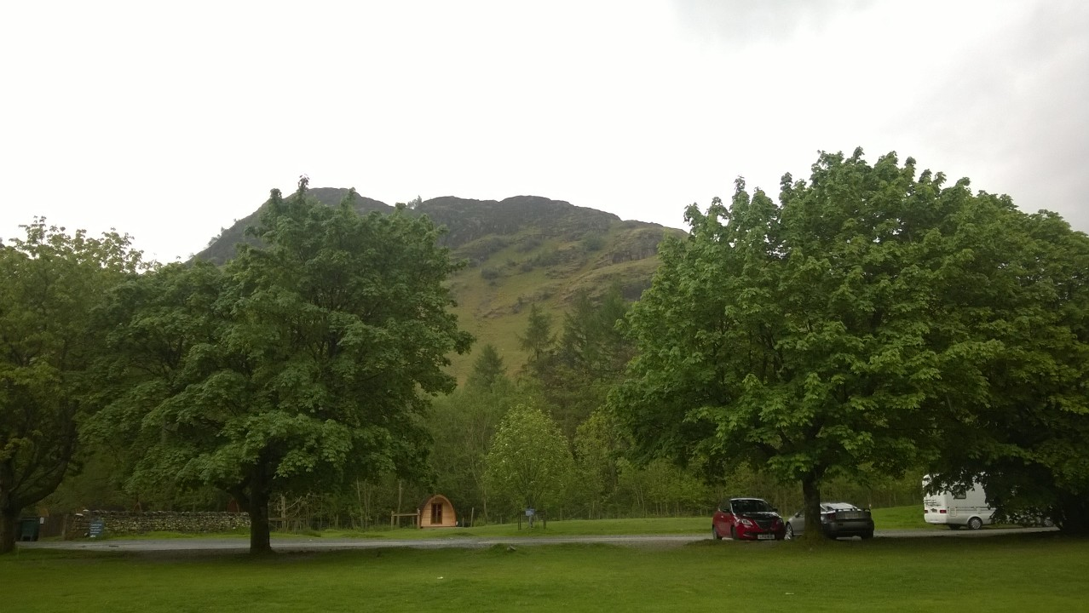

Slide 19
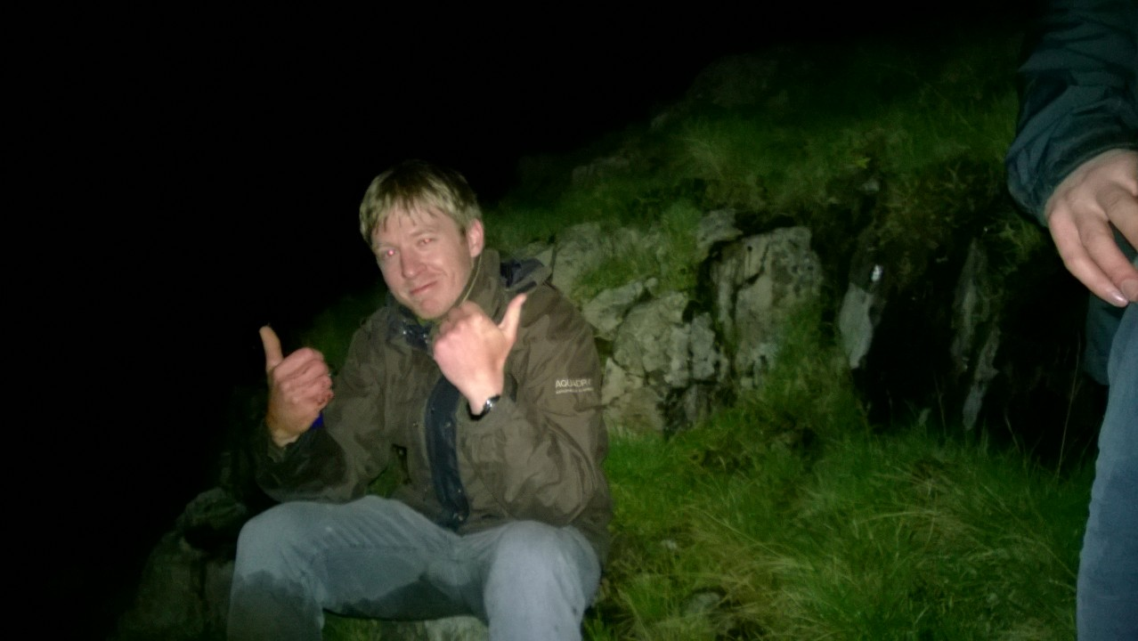

Slide 20
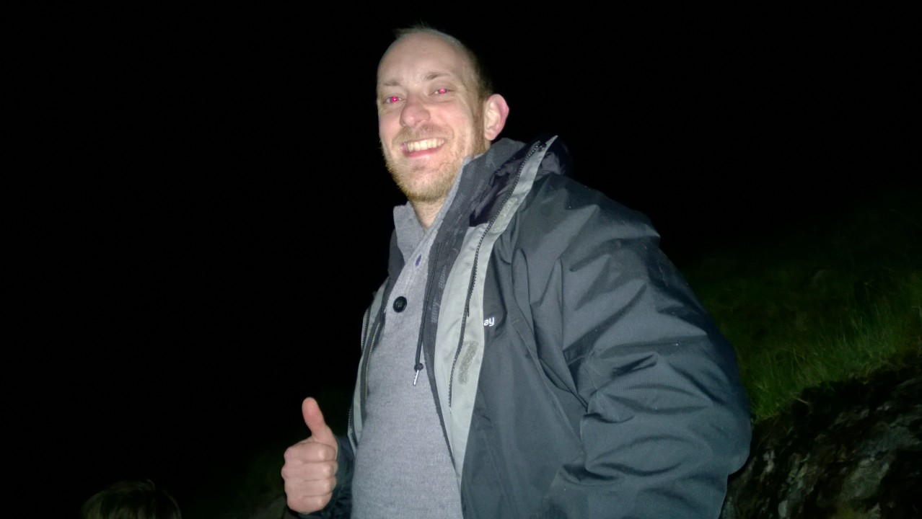

Slide 21
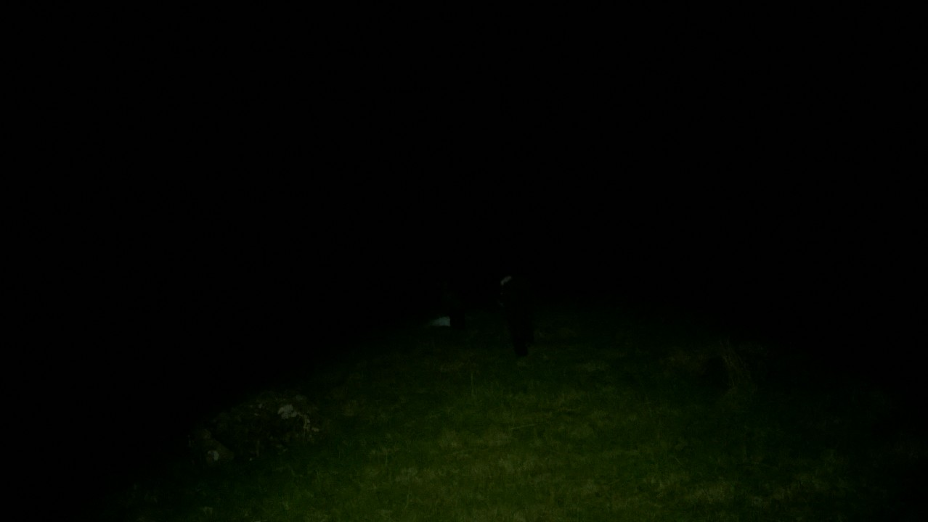

Slide 22
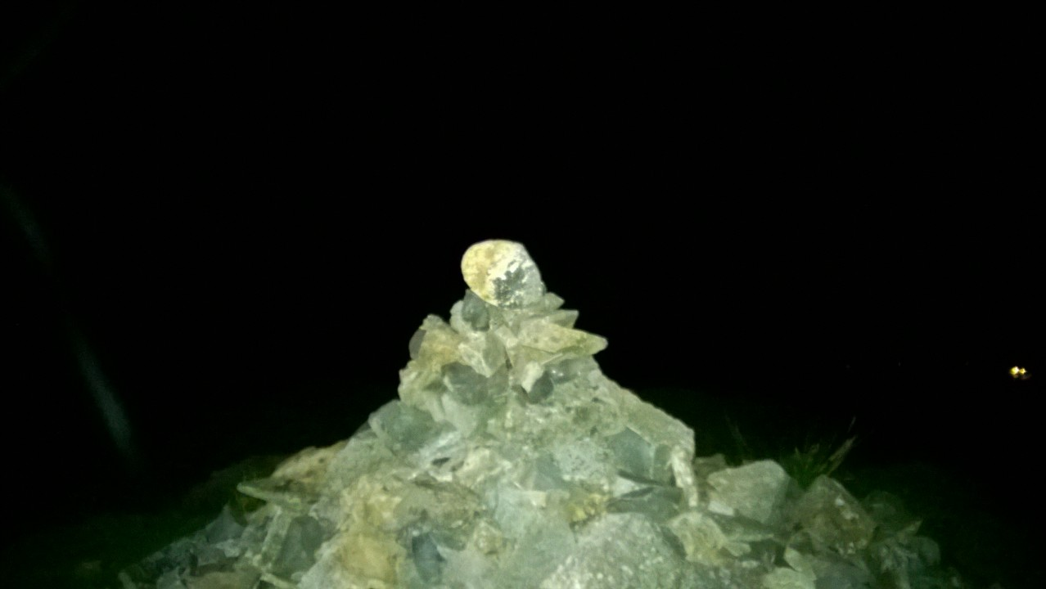

Slide 23
Climbing Mountains

Slide 24
Summary

Slide 25
What to Take Away.
Find the a balance for when to be rational and when to be human.
Improve your wellbeing - pimp your office.
Climb more mountains (sober).

Slide 26
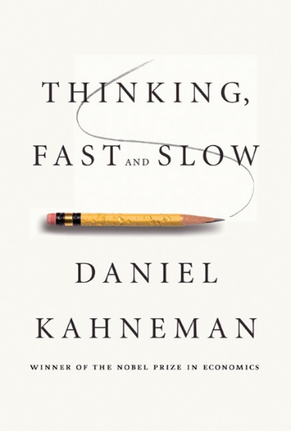
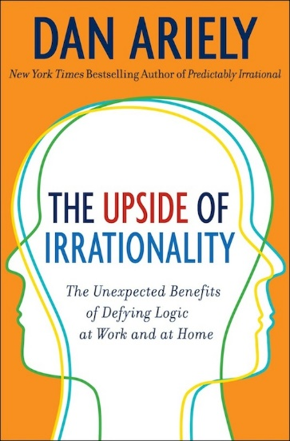
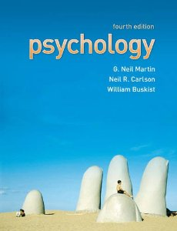

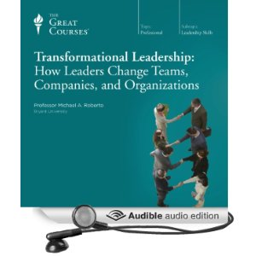
Sources
Dan Arielys’ TED Talk - http://www.ted.com/talks/dan_ariely_what_makes_us_feel_good_about_our_work
National Decision Making - Modelhttp://www.acpo.police.uk/documents/president/201201pbandm.pdf

Slide 27
How to Make the Best Cup of Coffee in the World

Slide 28
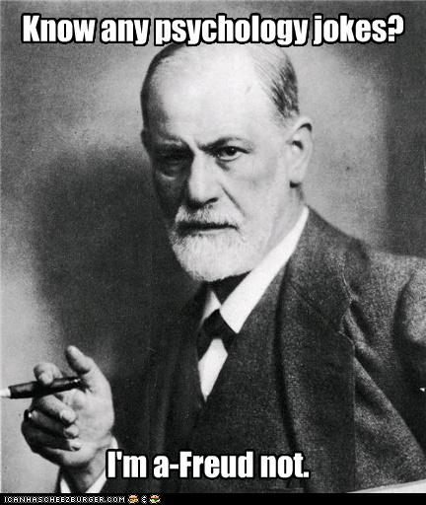
Answer: PSYCHOLOGY! BOOM!

Slide 29
Cheers for listening!
Rob Bollons • @robbollons • thenorthcode.net

